Slide 1

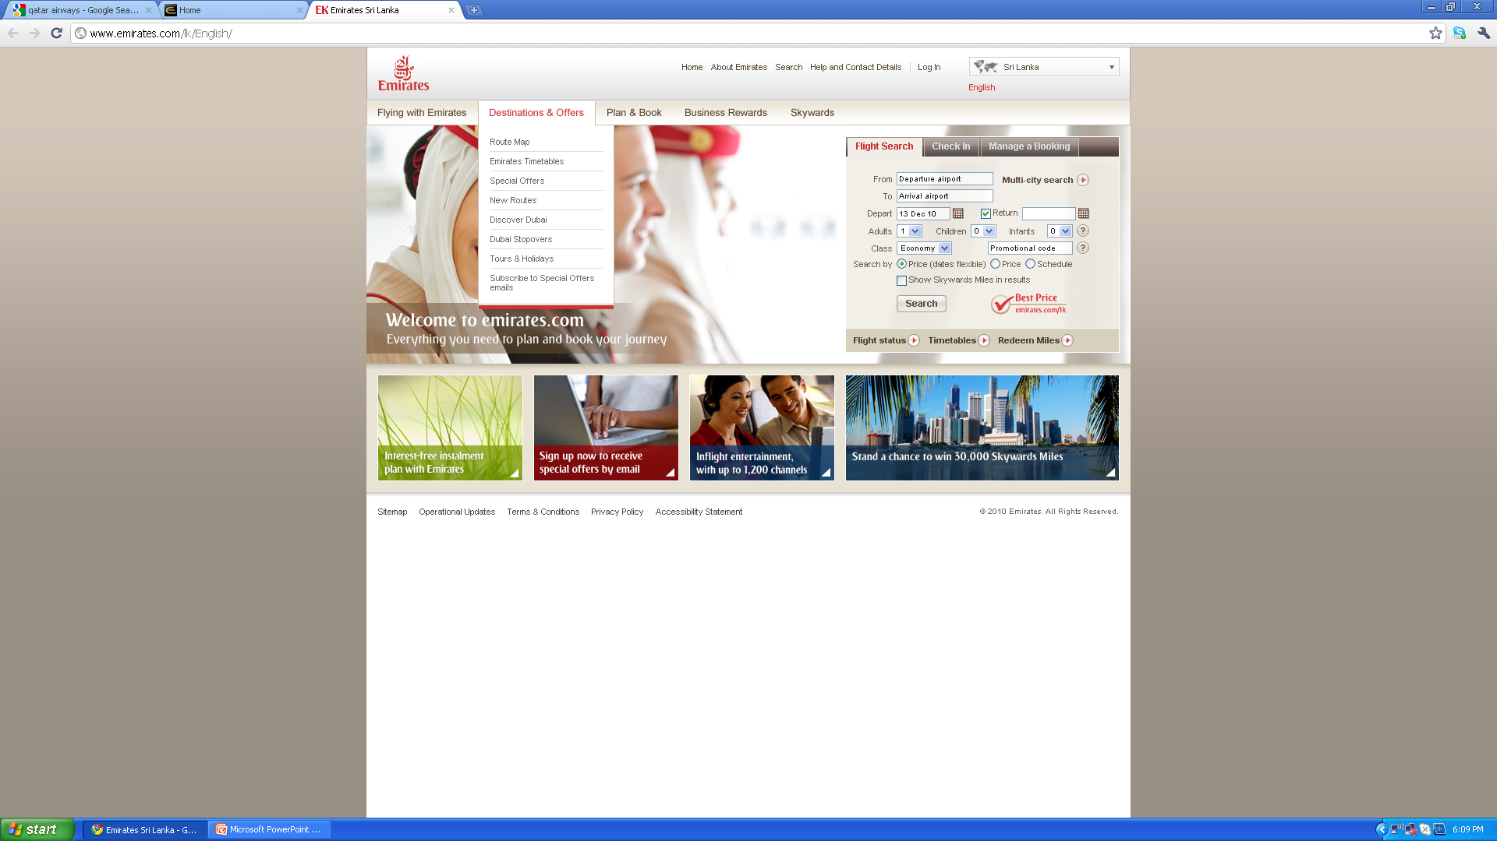
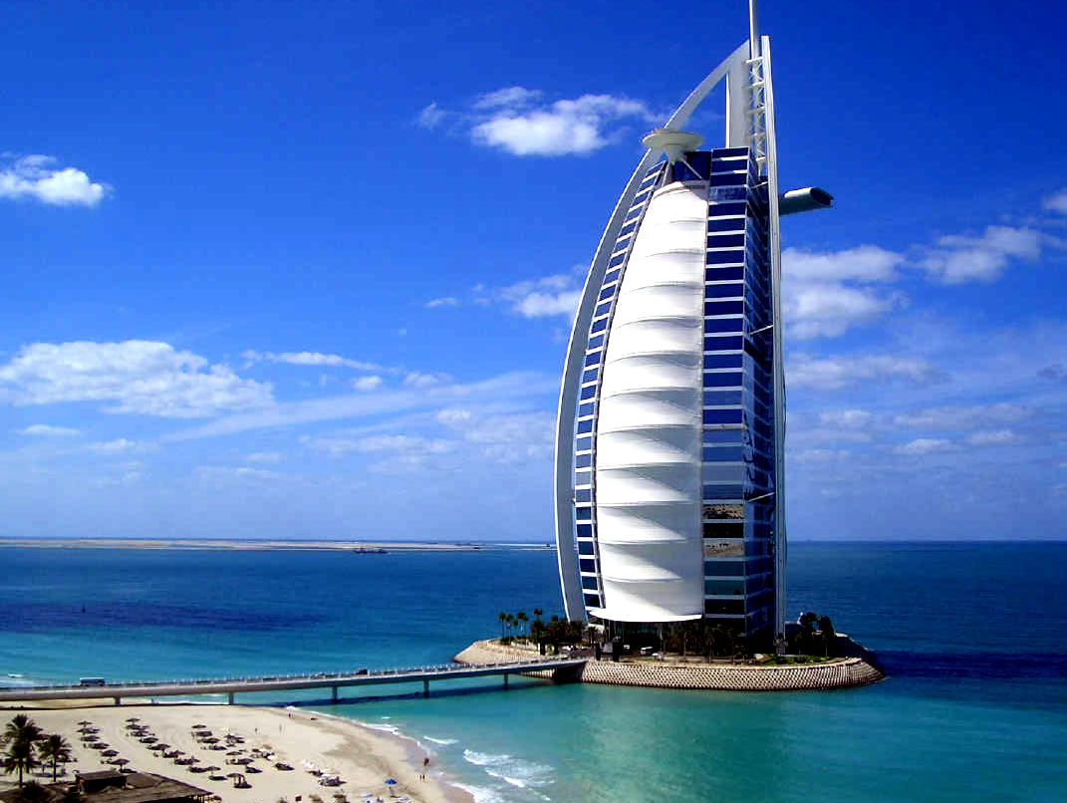
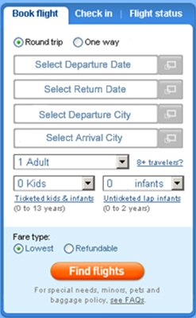


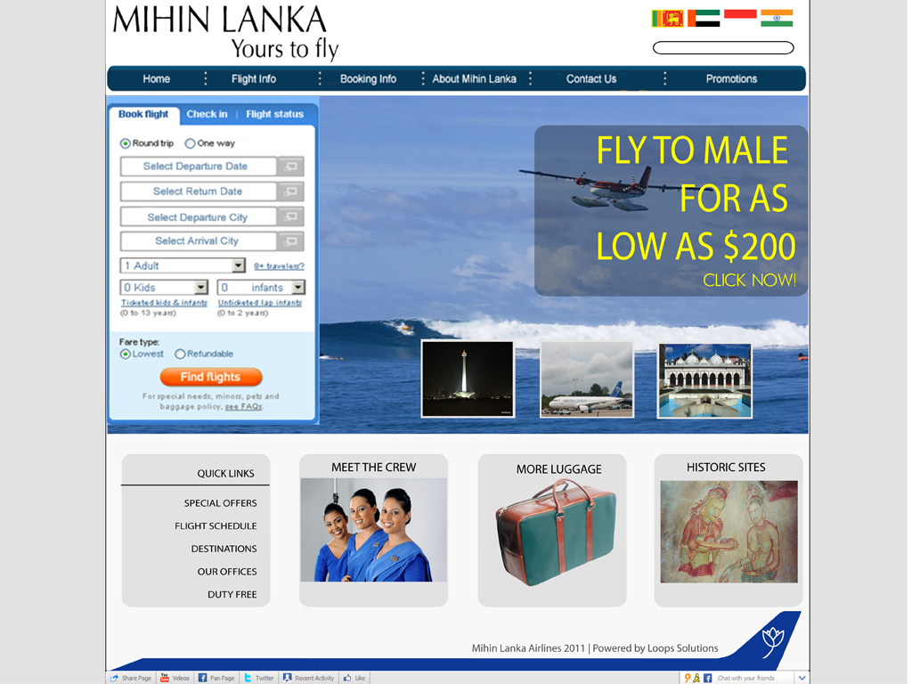
Home Flight Info Booking Info About Mihin Contact Us
Fly away to Sunny Maldives
Lets go!
<
Colombo to Dubai
from LKR
30,000
Colombo to Male
from LKR
15,000
Colombo to Jakarta
from LKR
35,000
Colombo to Trichy
from LKR
10,000
Lets go!
Lets go!
Lets go!
Lets go!
NEWS UPDATE
Mihin Lanka introduces a toll free number to call within UAE (More Info)
Quick Links
Terms & Conditions | Conditions of Carriage
Mihin Lanka Airlines 2011| Powered by

Slide 2


Home Flight Info Booking Info About Mihin Contact Us
Live it up in Dubai for only LKR 30,000 Return
<
Lets go!
Colombo to Dubai
from LKR
30,000
Colombo to Male
from LKR
15,000
Colombo to Jakarta
from LKR
35,000
Colombo to Trichy
from LKR
10,000
Lets go!
Lets go!
Lets go!
Lets go!
NEWS UPDATE
Mihin Lanka introduces a toll free number to call within UAE (More Info)
Our Offices
Contact Us
Duty Free
Baggage allowance
Arrivals & Departures
Our Destinations
Retrieve Booking
Quick Links
Terms & Conditions | Conditions of Carriage
Mihin Lanka Airlines 2011| Powered by

Slide 3

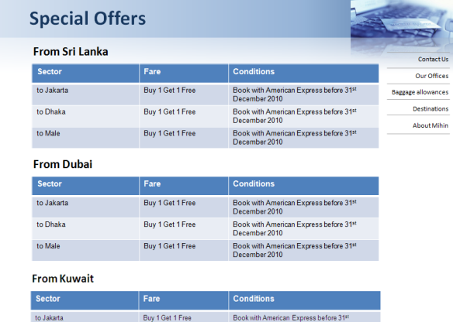
Home Flight Info Booking Info About Mihin Contact Us
Special Offers
Destinations
Baggage allowance
On Board services
Arrivals & Departures
Duty Free
FAQ
Click Here to see our special offers and promotions
Fly away to Sunny Maldives
Lets go!
<
Colombo to Dubai
from LKR
30,000
Colombo to Male
from LKR
15,000
Colombo to Jakarta
from LKR
35,000
Colombo to Trichy
from LKR
10,000
Lets go!
Lets go!
Lets go!
Lets go!
NEWS UPDATE
Mihin Lanka introduces a toll free number to call within UAE (More Info)
Quick Links
Terms & Conditions | Conditions of Carriage
Mihin Lanka Airlines 2011| Powered by

Slide 4




Register for E-Alerts
Home Flight info Booking info About us Contact us Promotions Our Offices Careers
About Mihin Lanka
Mihin Lanka is the budget airline of Democratic Socialist Republic of Sri Lanka, which was formed to cater for low cost air transportation to the traveling public. We commenced our operation on 24th April 2007 flying to Dubai in UAE & with a view to expand to India, Middle East, and other regions. We are represented by appointed General Sales Agents in India, Dubai, Maldives, Qatar, Kuwait and Korea. In Sri Lanka we have more than 100 active agents out of which 75 agents are registered with us and actively promoting our services.
We have a friendly and a well trained crew to welcome you on board. Mihin Lanka operates its international flights from Bandaranaike International Airport and the airport is equipped with up-to-date aircraft landing systems. It also has facilities and modern terminals where passengers are offered a wide range of services.
Our aim is to continue and establish long-term and reliable business contacts, and enhance the route network in order to meet the expectations of our passengers.
Contact Us
Our Offices
Baggage allowances
Destinations
About Mihin
Click to Book Online
Click Here to see Special Offers
Terms & Conditions | Conditions of Carriage
Mihin Lanka Airlines 2011| Powered by

Slide 5
Register for E-Alerts
Home Flight info Booking info About us Contact us Promotions Our Offices Careers
About Mihin Lanka
Mihin Lanka is the budget airline of Democratic Socialist Republic of Sri Lanka, which was formed to cater for low cost air transportation to the traveling public. We commenced our operation on 24th April 2007 flying to Dubai in UAE & with a view to expand to India, Middle East, and other regions. We are represented by appointed General Sales Agents in India, Dubai, Maldives, Qatar, Kuwait and Korea. In Sri Lanka we have more than 100 active agents out of which 75 agents are registered with us and actively promoting our services.
We have a friendly and a well trained crew to welcome you on board. Mihin Lanka operates its international flights from Bandaranaike International Airport and the airport is equipped with up-to-date aircraft landing systems. It also has facilities and modern terminals where passengers are offered a wide range of services.
Our aim is to continue and establish long-term and reliable business contacts, and enhance the route network in order to meet the expectations of our passengers.
Contact Us
Our Offices
Baggage allowances
Destinations
About Mihin
Click to Book Online
Terms & Conditions | Conditions of Carriage
Mihin Lanka Airlines 2011| Powered by

Slide 6



Register for E-Alerts
Home Flight info Booking info About us Contact us Promotions Our Offices Careers
About Mihin Lanka
Mihin Lanka is the budget airline of Democratic Socialist Republic of Sri Lanka, which was formed to cater for low cost air transportation to the traveling public. We commenced our operation on 24th April 2007 flying to Dubai in UAE & with a view to expand to India, Middle East, and other regions. We are represented by appointed General Sales Agents in India, Dubai, Maldives, Qatar, Kuwait and Korea. In Sri Lanka we have more than 100 active agents out of which 75 agents are registered with us and actively promoting our services.
We have a friendly and a well trained crew to welcome you on board. Mihin Lanka operates its international flights from Bandaranaike International Airport and the airport is equipped with up-to-date aircraft landing systems. It also has facilities and modern terminals where passengers are offered a wide range of services.
Our aim is to continue and establish long-term and reliable business contacts, and enhance the route network in order to meet the expectations of our passengers.
Contact Us
Our Offices
Baggage allowances
Destinations
About Mihin
Click to Book Online
Click Here to see Special Offers
Terms & Conditions | Conditions of Carriage
Mihin Lanka Airlines 2011| Powered by

Slide 7

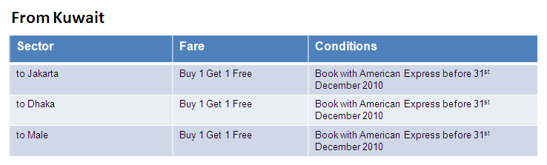
Register for E-Alerts
Home Flight info Booking info About us Contact us Promotions Our Offices Careers
Special Offers
From Sri Lanka
Contact Us
Our Offices
Baggage allowances
Destinations
About Mihin
Sector | Fare | Conditions
to Jakarta | Buy 1 Get 1 Free | Book with American Express before 31st December 2010
to Dhaka | Buy 1 Get 1 Free | Book with American Express before 31st December 2010
to Male | Buy 1 Get 1 Free | Book with American Express before 31st December 2010
Click to Book Online
From Dubai
Sector | Fare | Conditions
to Jakarta | Buy 1 Get 1 Free | Book with American Express before 31st December 2010
to Dhaka | Buy 1 Get 1 Free | Book with American Express before 31st December 2010
to Male | Buy 1 Get 1 Free | Book with American Express before 31st December 2010
Click Here to see Special Offers
Terms & Conditions | Conditions of Carriage
Mihin Lanka Airlines 2011| Powered by

Slide 8
Register for E-Alerts
Home Flight info Booking info About us Contact us Promotions Our Offices Careers
☒
Special Offers
Are you interested in receiving E-Mail Alerts when there are special Fares?
From Sri Lanka
Yes
No
Contact Us
Our Offices
Baggage allowances
Destinations
About Mihin
Sector | Fare | Conditions
to Jakarta | Buy 1 Get 1 Free | Book with American Express before 31st December 2010
to Dhaka | Buy 1 Get 1 Free | Book with American Express before 31st December 2010
to Male | Buy 1 Get 1 Free | Book with American Express before 31st December 2010
Click to Book Online
From Dubai
Sector | Fare | Conditions
to Jakarta | Buy 1 Get 1 Free | Book with American Express before 31st December 2010
to Dhaka | Buy 1 Get 1 Free | Book with American Express before 31st December 2010
to Male | Buy 1 Get 1 Free | Book with American Express before 31st December 2010
Click Here to see Special Offers
Terms & Conditions | Conditions of Carriage
Mihin Lanka Airlines 2011| Powered by

Slide 9
Register for E-Alerts
Home Flight info Booking info About us Contact us Promotions Our Offices Careers
Special Offers
From Sri Lanka
Please fill the below form in order to be among the first to be informed of any special offers and promotions from Mihin Lanka as soon as they are introduced!
Contact Us
Our Offices
Baggage allowances
Destinations
About Mihin
Sector | Fare | Conditions
to Jakarta | Buy 1 Get 1 Free | Book with American Express before 31st December 2010
to Dhaka | Buy 1 Get 1 Free | Book with American Express before 31st December 2010
to Male | Buy 1 Get 1 Free | Book with American Express before 31st December 2010
Title: *
Click to Book Online
Full Name:*
Address
From Dubai
Sector | Fare | Conditions
to Jakarta | Buy 1 Get 1 Free | Book with American Express before 31st December 2010
to Dhaka | Buy 1 Get 1 Free | Book with American Express before 31st December 2010
to Male | Buy 1 Get 1 Free | Book with American Express before 31st December 2010
Mobile No:
Other Number:
Click Here to see Special Offers
E-Mail Address:*
Country:
* Mandatory Information
Submit
Terms & Conditions | Conditions of Carriage
Mihin Lanka Airlines 2011| Powered by

